Slide 1

High-Precision Object Detection Model for Real-World Applications
Introducing a cutting-edge deep learning architecture that pushes the boundaries of real-time object detection, designed to thrive in critical real-world scenarios like surveillance, traffic control, and emergency response.

Slide 2

Problem Statement
1
Objective
2
Challenges
Address the need for highly accurate, low-latency object detection in high-stakes applications like surveillance, traffic monitoring, and emergency response.
Overcome issues with high false positives, poor performance in low-light conditions, and unacceptable delays in critical decision-making scenarios.

Slide 3
Unique Selling Points (USPs)
1
High Precision and Low Latency
2
Low-Light Performance
Accurate detection with minimal false positives and near-instantaneous results.
Specially trained to perform effectively in low-visibility conditions, essential for night surveillance.
3
Multi-Object Detection & Tracking
4
Adaptability Across Environments
Tracks multiple objects like vehicles, license plates, and people in real-time.
Handles varied lighting, angles, and occlusions.

Slide 4
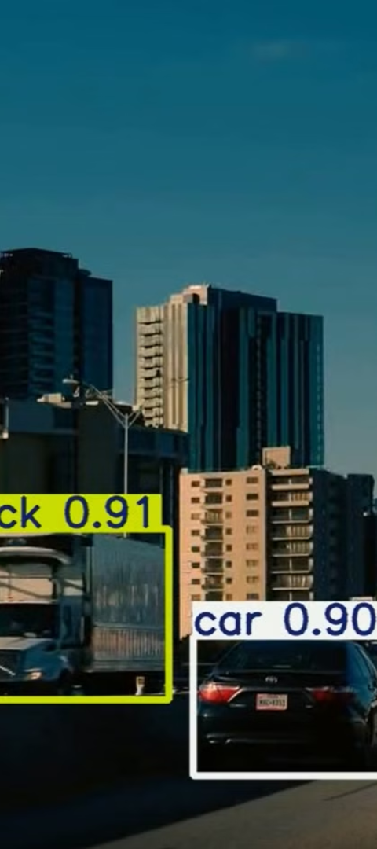
Model Used:
YOLO v11
custom model(potHole)
Purpose:
Advanced, high-precision model optimized for real-world object detection
Datasets:
COCO Dataset: Comprehensive baseline for general object detection
Custom License Plate Dataset: Tailored for license plate recognition
Pot Hole Dataset: Tailored for Pot Hole detection
Capabilities :
1
Multi-Object Detection
Recognizes and tracks vehicles, people, license plates, and more
2
Real-World Adaptability
Performs reliably in diverse environments, day or night

Slide 5

Technology Stack
Core Frameworks and Tools:
YOLO by Ultralytics: Customized YOLO v11 implementation for advanced detection capabilities.
Data Handling:
COCO.yaml Configuration: Supports general object detection with ease of customization.
Custom Dataset Integration: Enhances model performance on license plate recognition and specialized tracking.
Hardware Compatibility:
Optimized for High-Performance GPUs and Edge Devices, ensuring scalable deployment.
Key Libraries:
OpenCV: For image pre-processing.
PyTorch: For efficient model training and fine-tuning.
YOLO Library: For real-time, scalable object detection.

Slide 6
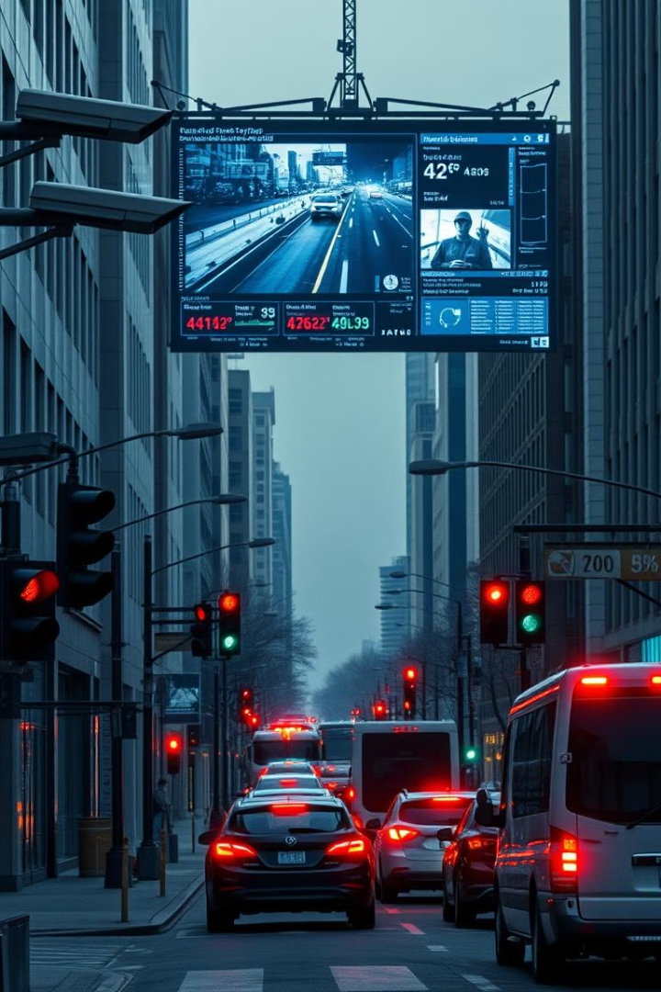
Features
1
Real-Time Processing
2
Robust Accuracy
High precision in object classification and localization, reducing false positives/negatives.
Delivers detections instantly, enabling timely decision-making in critical applications.
3
Low-Light Performance
4
Scalability
Compatible with multiple resolutions and easily deployable on both powerful GPUs and resource-limited devices.
Specially fine-tuned for high accuracy even in low-visibility conditions, ideal for nighttime surveillance.

Slide 7
Real-World Applications
Surveillance
1
Detects unauthorized persons and vehicles in secured areas.
2
Traffic Control
Low-light capability allows for reliable night-time monitoring.
Monitors traffic flow, detects incidents (e.g., accidents, stopped vehicles).
Assists automated systems in identifying traffic signals, vehicles, and pedestrians.
Emergency Response
3
Rapid identification of accidents or unusual patterns for quick response.
Tracks emergency vehicles for efficient traffic management and resource allocation.
4
Road Condition Monitoring
Detects and identifies potholes and road surface issues, enabling early intervention and maintenance. Helps improve road safety by providing insights for timely repairs.

Slide 8

Future Scope
1
Enhanced Tracking Capabilities
2
Low-Light Optimization
Implementation of advanced algorithms for improved object continuity across frames, essential for moving scenes.
Further training on specialized low-light datasets to boost detection accuracy in nighttime conditions.
3
Expansion to New Domains
4
Edge Device Compatibility
Potential for retail automation (customer behavior tracking) and public safety monitoring.
Model optimization for resource-constrained environments like smart cameras and IoT devices, broadening deployment options.
5
Conclusion
1
Transformative Impact
2
Commitment to Excellence
YOLO v11 represents a significant leap forward in real-time object detection, empowering critical applications with unparalleled precision and reliability.
Our team is dedicated to continuous innovation and collaboration to ensure our solutions meet the evolving needs of the real world.

Slide 9

Team members: Virti Panchamia : virtipanchamia25@gmail.com
Jainam Dedhia: jainamdedhia5@gmail.com
Thank You
We appreciate your interest in our groundbreaking work. Let's continue to push the boundaries of what's possible in the world of AI-powered object detection.

